Slide 1
Programming Language II C#
Lecture – 1
Introduction

Slide 2
Introduction to C#
simple, modern
object-oriented programming language
developed by Microsoft
within its .NET initiative led by Anders Hejlsberg.

Slide 3
Introduction to C#
C# is designed for Common Language Infrastructure (CLI), which consists of the executable code and runtime environment that allows use of various high-level languages on different computer platforms and architectures.

Slide 4
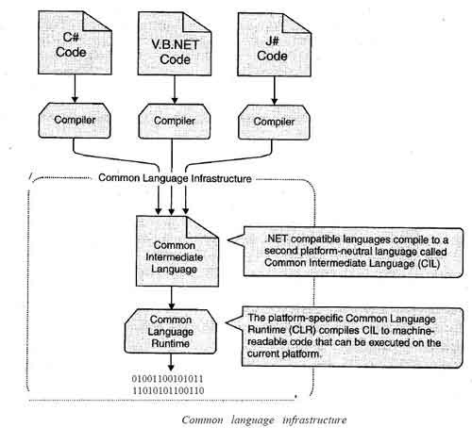

Slide 5
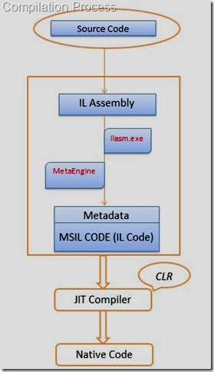
IL Assembly (Intermediate Language Assembly)
Native code (Machine understandable code)
JIT compiler(Just-In-Time Compiler)
CLR(Common Language Runtime)

Slide 6
Introduction to C#
The following reasons make C# a widely used professional language:
It is a modern, general-purpose programming language
It is object oriented.
It is component oriented.
It is easy to learn.
It is a structured language.
It produces efficient programs.
It can be compiled on a variety of computer platforms.
It is a part of .Net Framework.

Slide 7
C# Programming environment online
Example:
rextester.com
csharppad.com
jdoodle.com

Slide 8
Integrated Development Environment (IDE) for C#
Microsoft provides the following development tools for C# programming:
Visual Studio 2010 (VS)
Visual C# 2010 Express (VCE)
Visual Web Developer
You can also write C# source code files using a basic text editor, like Notepad, and compile the code into assemblies using the command-line compiler.

Slide 9
Installation
You can download it from https://www.visualstudio.com/vs/
It gets installed automatically on your machine.

Slide 10
Writing C# Programs on Linux or Mac OS
Mono is an open-source version of the .NET Framework which includes a C# compiler and runs on several operating systems, including various flavors of Linux and Mac OS.
http://www.mono-project.com/download/

Slide 11
using System;
namespace FirstApplication
{
class LearnPrint
{
static void Main(string[] args) {
Console.WriteLine("Hello World"); Console.ReadKey();
}
}
}

Slide 12
Explanation
using System; - the using keyword is used to include the System namespace in the program.
namespace is a collection of classes. The FirstApplication namespace contains the class LearnPrint.
class declaration, the class LearnPrint contains the data and method definitions that your program uses. Classes generally contain multiple methods. Methods define the behavior of the class. However, the LearnPrint class has only one method Main.
Main method, which is the entry point for all C# programs. The Main method states what the class does when executed.
Console.WriteLine("Hello World");
WriteLine is a method of the Console class defined in the System namespace. This statement causes the message "Hello, World!" to be displayed on the screen.
Console.ReadKey(). This makes the program wait for a key press and it prevents the screen from running and closing quickly when the program is launched

Slide 13
Important
C# is case sensitive.
All statements and expression must end with a semicolon (;).
The program execution starts at the Main method.

